Slide 1
Week 7
Software security
Operating system security
Cloud and iot security

Slide 2
Chapter 11
Software Security

Slide 3
CWE/SANS Top 25 Most Dangerous Software Errors (2011)

Slide 4
Security Flaws
These flaws occur as a consequence of insufficient checking and validation of data and error codes in programs
Awareness of these issues is a critical initial step in writing more secure program code
Emphasis should be placed on the need for software developers to address these known areas of concern
Critical Web application security flaws include five related to insecure software code
Unvalidated input
Cross-site scripting
Buffer overflow
Injection flaws
Improper error handling

Slide 5
Reducing Software Vulnerabilities
The NIST report NISTIR 8151 presents a range of approaches to reduce the number of software vulnerabilities
It recommends:
Stopping vulnerabilities before they occur by using improved methods for specifying and building software
Finding vulnerabilities before they can be exploited by using better and more efficient testing techniques
Reducing the impact of vulnerabilities by building more resilient architectures

Slide 6
Software Quality/Reliability vs Security
Software quality and reliability:
Concerned with the accidental failure of program as a result of some theoretically random, unanticipated input, system interaction, or use of incorrect code
Improve using structured design and testing to identify and eliminate as many bugs as possible from a program
Concern is not how many bugs, but how often they are triggered
Software security:
Attacker chooses probability distribution, specifically targeting bugs that result in a failure that can be exploited by the attacker
Triggered by inputs that differ dramatically from what is usually expected
Unlikely to be identified by common testing approaches

Slide 7
Defensive Programming
Also referred to as secure programming
Designing and implementing software so that it continues to function even when under attack
Requires attention to all aspects of program execution, environment, and type of data it processes
Software is able to detect erroneous conditions resulting from some attack
Key rule is to never assume anything, check all assumptions and handle any possible error states

Slide 8
Defensive Programming - Challenges
Programmers often make assumptions about the type of inputs a program will receive and the environment it executes in
Assumptions need to be validated by the program and all potential failures handled gracefully and safely
Requires a changed mindset to traditional programming practices
Programmers have to understand how failures can occur and the steps needed to reduce the chance of them occurring in their programs
Conflicts with business pressures to keep development times as short as possible to maximize market advantage

Slide 9
Defensive Programming - Topics
Input validation
Correct data interpretation
Handling of race conditions
Shell script execution vulnerabilities
Use of privileges (root)
Flie I/O
Inter-program communications
Use of third-party software and libraries

Slide 10
Chapter 12
Operating System Security

Slide 11
OS Security Layers

Slide 12
Operating System Security
Possible for a system to be compromised during the installation process before it can install the latest patches
Building and deploying a system should be a planned process designed to counter this threat
Process must:
Assess risks and plan the system deployment
Secure the underlying operating system and then the key applications
Ensure any critical content is secured
Ensure appropriate network protection mechanisms are used
Ensure appropriate processes are used to maintain security

Slide 13
System Security Planning Process
The purpose of the system, the type of information stored, the applications and services provided, and their security requirements
The categories of users of the system, the privileges they have, and the types of information they can access
How the users are authenticated
How access to the information stored on the system is managed
What access the system has to information stored on other hosts, such as file or database servers, and how this is managed
Who will administer the system, and how they will manage the system (via local or remote access)
Any additional security measures required on the system, including the use of host firewalls, anti-virus or other malware protection mechanisms, and logging

Slide 14
Operating Systems Hardening
First critical step in securing a system is to secure the base operating system
Basic steps
Install and patch the operating system
Harden and configure the operating system to adequately address the identified security needs of the system by:
Removing unnecessary services, applications, and protocols
Configuring users, groups, and permissions
Configuring resource controls
Install and configure additional security controls, such as anti-virus, host-based firewalls, and intrusion detection system (IDS)
Test the security of the basic operating system to ensure that the steps taken adequately address its security needs

Slide 15
Security Maintenance
Process of maintaining security is continuous
Security maintenance includes:
Monitoring and analyzing logging information
Performing regular backups
Recovering from security compromises
Regularly testing system security
Using appropriate software maintenance processes to patch and update all critical software, and to monitor and revise configuration as needed

Slide 16
Logging
Can only inform you about bad things that have already happened
In the event of a system breach or failure, system administrators can more quickly identify what happened
Key is to ensure you capture the correct data and then appropriately monitor and analyze this data
Information can be generated by the system, network and applications
Range of data acquired should be determined during the system planning stage
Generates significant volumes of information and it is important that sufficient space is allocated for them
Automated analysis is preferred

Slide 17
Windows Security User Administration and Access Control
Windows systems also define privileges
System wide and granted to user accounts
Combination of share and NTFS permissions may be used to provide additional security and granularity when accessing files on a shared resource
User Account Control (UAC)
Provided in Vista and later systems
Assists with ensuring users with administrative rights only use them when required, otherwise accesses the system as a normal user
Low Privilege Service Accounts
Used for long-lived service processes such as file, print, and DNS services

Slide 18
Virtualization (VMs, Containers)
A technology that provides an abstraction of the resources used by some software which runs in a simulated environment called a virtual machine (VM)
Benefits include better efficiency in the use of the physical system resources
Provides support for multiple distinct operating systems and associated applications on one physical system
Raises additional security concerns

Slide 19
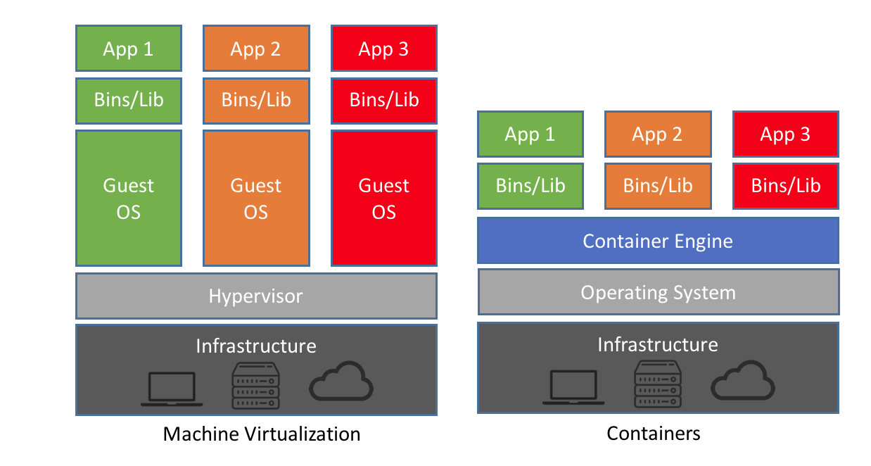
Containers
A recent approach to virtualization is known as container virtualization or application virtualization
In this approach, software known as a virtualization container, runs on top of the host OS kernel and provides an isolated execution environment for applications
Unlike hypervisor-based VMs, containers do not aim to emulate physical servers
All containerized applications on a host share a common OS kernel
For containers, only a small container engine is required as support for the containers
Containerization sits in between the OS and applications and incurs lower overhead, but potentially introduces greater security vulnerabilities

Slide 20
Virtualization Security Issues
Security concerns include:
Guest OS isolation
Ensuring that programs executing within a guest OS may only access and use the resources allocated to it
Guest OS monitoring by the hypervisor
Which has privileged access to the programs and data in each guest OS
Virtualized environment security
Particularly image and snapshot management which attackers may attempt to view or modify

Slide 21
Virtualized Infrastructure Security
Systems manage access to hardware resources
Access must be limited to just the appropriate guest OSs
Access to VM image and snapshots must be carefully controlled

Slide 22
Chapter 13
Cloud and IoT Security

Slide 23
Cloud Computing
NIST defines cloud computing, in NIST SP-800-145 (The NIST Definition of Cloud Computing, September 2011) as follows:
“Cloud computing: A model for enabling ubiquitous, convenient, on-demand network access to a shared pool of configurable computing resources (e.g., networks, servers, storage, applications, and services) that can be rapidly provisioned and released with minimal management effort or service provider interaction. This cloud model promotes availability and is composed of five essential characteristics, three service models, and four deployment models.”

Slide 24
Cloud Computing - Depiction

Slide 25
Cloud Service Models
NIST defines three service models, which can be viewed as nested service alternatives
Software as a service (SaaS)
Platform as a service (PaaS)
Infrastructure as a service (IaaS)

Slide 26
Software as a Service (SaaS)
SaaS provides service to customers in the form of software, specifically application software, running on and accessible in the cloud
It enables the customer to use the cloud provider’s applications running on the provider’s cloud infrastructure
The applications are accessible from various client devices through a simple interface, such as a Web browser
Instead of obtaining desktop and server licenses for software products it uses, an enterprise obtains the same functions from the cloud service
The use of SaaS avoids the complexity of software installation, maintenance, upgrades, and patches
Examples of this service are Google Gmail, Microsoft 365, Salesforce, Citrix GoToMeeting, and Cisco WebEx

Slide 27
Platform as a Service (PaaS)
A PaaS cloud provides service to customers in the form of a platform on which the customer’s applications can run
PaaS enables the customer to deploy onto the cloud infrastructure customer-created or acquired applications
A PaaS cloud provides useful software building blocks, plus a number of development tools, such as programming language tools, run-time environments, and other tools that assist in deploying new applications
In effect, PaaS is an operating system in the cloud
It is useful for an organization that wants to develop new or tailored applications while paying for the needed computing resources only as needed, and only for as long as needed
Examples of PaaS include AppEngine, Engine Yard, Heroku, Microsoft Azure, Force.com, and Redhat Openshift

Slide 28
Infrastructure as a Service (IaaS)
With IaaS, the customer has access to the resources of the underlying cloud infrastructure
The cloud service user does not manage or control the resources of the underlying cloud infrastructure, but has control over operating systems, deployed applications, and possibly limited control of select networking components
IaaS provides virtual machines and other virtualized hardware and operating systems
IaaS offers the customer processing, storage, networks, and other fundamental computing resources so the customer is able to deploy and run arbitrary software, which can include operating systems and applications
IaaS enables customers to combine basic computing services, such as number crunching and data storage, to build highly adaptable computer systems
Examples of IaaS are AWS, Google Compute Engine, and IBM Cloud

Slide 29
Public Cloud
A public cloud infrastructure is made available to the general public or a large industry group, and is owned by an organization selling cloud services
The cloud provider is responsible both for the cloud infrastructure and for the control of data and operations within the cloud
A public cloud may be owned, managed, and operated by a business, academic, or government organization, or some combination of them
All major components are outside the enterprise firewall, located in a multitenant infrastructure
Applications and storage are made available over the Internet via secured IP, and can be free or offered at a pay-per-usage fee
The major advantage of the public cloud is cost
The principal concern is security

Slide 30
Private Cloud
A private cloud is implemented within the internal IT environment of the organization
The organization may choose to manage the cloud in house or contract the management function to a third party
The cloud servers and storage devices may exist on premise or off premise
Private clouds can deliver IaaS internally to employees or busines units through an intranet or the Internet via a virtual private network (VPN), as well as software or storage as services to its branch offices
Examples of services delivered through the private cloud include database on demand, email on demand, and storage on demand
A key motivation for opting for a private cloud is security
Other benefits include easy resource sharing and rapid deployment to organizational entities

Slide 31
Hybrid Cloud
The hybrid cloud infrastructure is a composition of two or more clouds (private, community, or public) that remain unique entities but are bound together by standardized or proprietary technology that enables data and application portability
With a hybrid cloud solution, sensitive information can be placed in a private area of the cloud, and less sensitive data can take advantage of the benefits of the public cloud
A hybrid public/private cloud solution can be particularly attractive for smaller business
Many applications for which security concerns are less can be offloaded at considerable cost savings without committing the organization to moving more sensitive data and applications to the public cloud

Slide 32
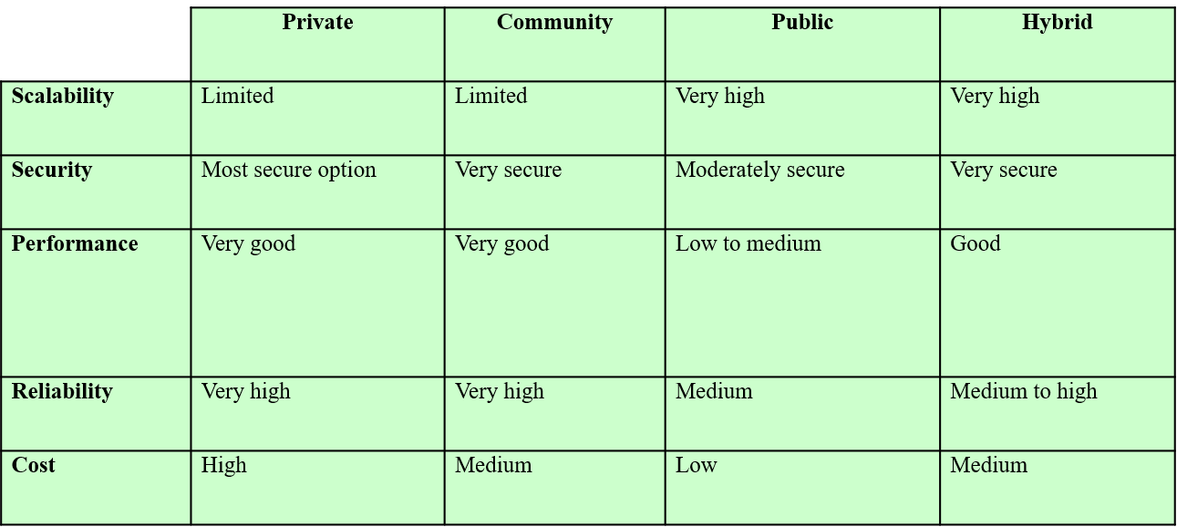
Comparison of Cloud Deployment Models

Slide 33
Security Issues for Cloud Computing
Security is a major consideration when augmenting or replacing on-premises systems with cloud services
Allaying security concerns is frequently a prerequisite for further discussions about migrating part or all of an organization’s computing architecture to the cloud
Availability is another major concern
Auditability of data must be ensured
Businesses should perform due diligence on security threats both from outside and inside the cloud
Cloud users are responsible for application-level security
Cloud vendors are responsible for physical security and some software security
Security for intermediate layers of the software stack is shared between users and vendors
Cloud providers must guard against theft or denial-of-service attacks by their users and users need to be protected from one another
Businesses should consider the extent to which subscribers are protected against the provider, especially in the area of inadvertent data loss

Slide 34
The Internet of Things (IoT)
IoT is a term that refers to the expanding interconnection of smart devices, ranging from appliances to tiny sensors
A dominant theme is the embedding of short-range mobile transceivers into a wide array of gadgets and everyday items, enabling new forms of communication between people and things, and between things themselves
The Internet supports the interconnectivity usually through cloud systems
The objects deliver sensor information, act on their environment, and in some cases modify themselves, to create overall management of a larger system
The IoT is primarily driven by deeply embedded devices
These devices are low-bandwidth, low-repetition data capture, and low-bandwidth data-usage appliances that communicate with each other and provide data via user interfaces
Embedded appliances, such as high-resolution video security cameras, video VoIP phones, and a handful of others, require high-bandwidth streaming capabilities

Slide 35
Evolution of IoT
With reference to the end systems supported, the Internet has gone through roughly four generations of deployment culminating in the IoT:
Information technology (IT)
PCs, servers, routers, firewalls, and so on, bought as IT devices by enterprise IT people, primarily using wired connectivity
Operational technology (OT)
Machines/appliances with embedded IT built by non-IT companies, such as medical machinery, SCADA, process control, and kiosks, bought as appliances by enterprise OT people, primarily using wired connectivity
Personal technology
Smartphones, tablets, and eBook readers bought as IT devices by consumers (employees) exclusively using wireless connectivity and often multiple forms of wireless connectivity
Sensor/actuator technology
Single-purpose devices bought by consumers, IT and OT people exclusively using wireless connectivity, generally of a single form, as part of larger systems
It is the fourth generation that is usually thought of as the IoT, and which is marked by the use of billions of embedded devices

Slide 36
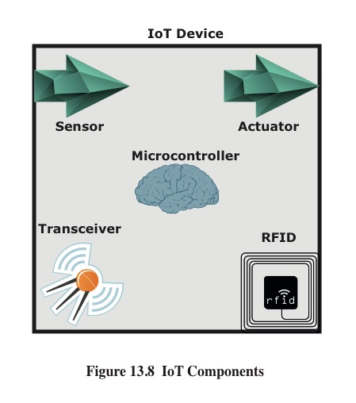
IoT Components

Slide 37
Edge
At the edge of a typical enterprise network is a network of IoT-enabled devices consisting of sensors and perhaps actuators
These devices may communicate with one another
A cluster of sensors may all transmit their data to one sensor that aggregates the data to be collected by a higher-level entity
A gateway interconnects the IoT-enabled devices with the higher-level communication networks
It performs the necessary translation between the protocols used in the communication networks and those used by devices
It may also perform a basic data aggregation function

Slide 38
Fog
In many IoT deployments, massive amounts of data may be generated by a distributed network of sensors
Rather than store all of that data permanently (or at least for a long period) in central storage accessible to IoT applications, it is often desirable to do as much data processing close to the sensors as possible
The purpose of what is sometimes referred to as the edge computing level is to convert network data flows into information that is suitable for storage and higher-level processing
Processing elements at these levels may deal with high volumes of data and perform data transformation operations, resulting in the storage of much lower volumes of data
The following are examples of fog computing operations:
Evaluation
Formatting
Expanding/decoding
Distillation/reduction
Assessment

Slide 39
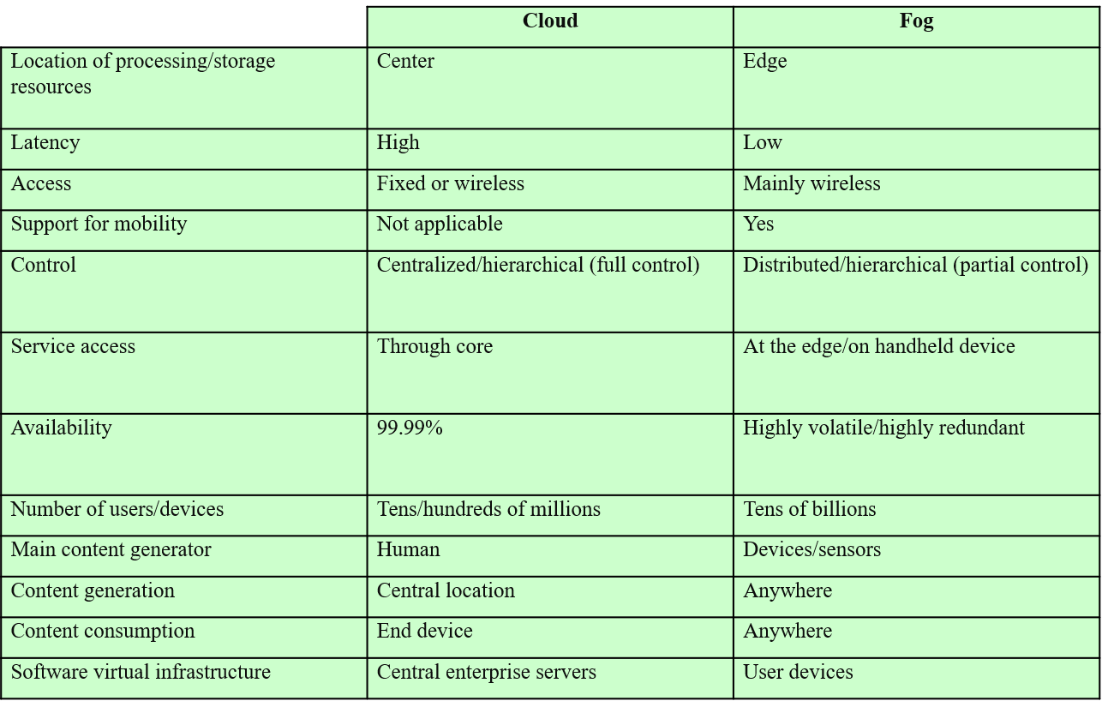
Cloud vs. Fog

Slide 40
IoT Security and Privacy Requirements
ITU-T Recommendation Y.2066 includes a list of security requirements for the IoT
The requirements are defined as being the functional requirements during capturing, storing, transferring, aggregating, and processing the data of things, as well as to the provision of services which involve things
The requirements are:
Communication security
Data management security
Service provision security
Integration of security policies and techniques
Mutual authentication and authorization
Security audit

Slide 41
IoT Gateway Security

